Slide 1
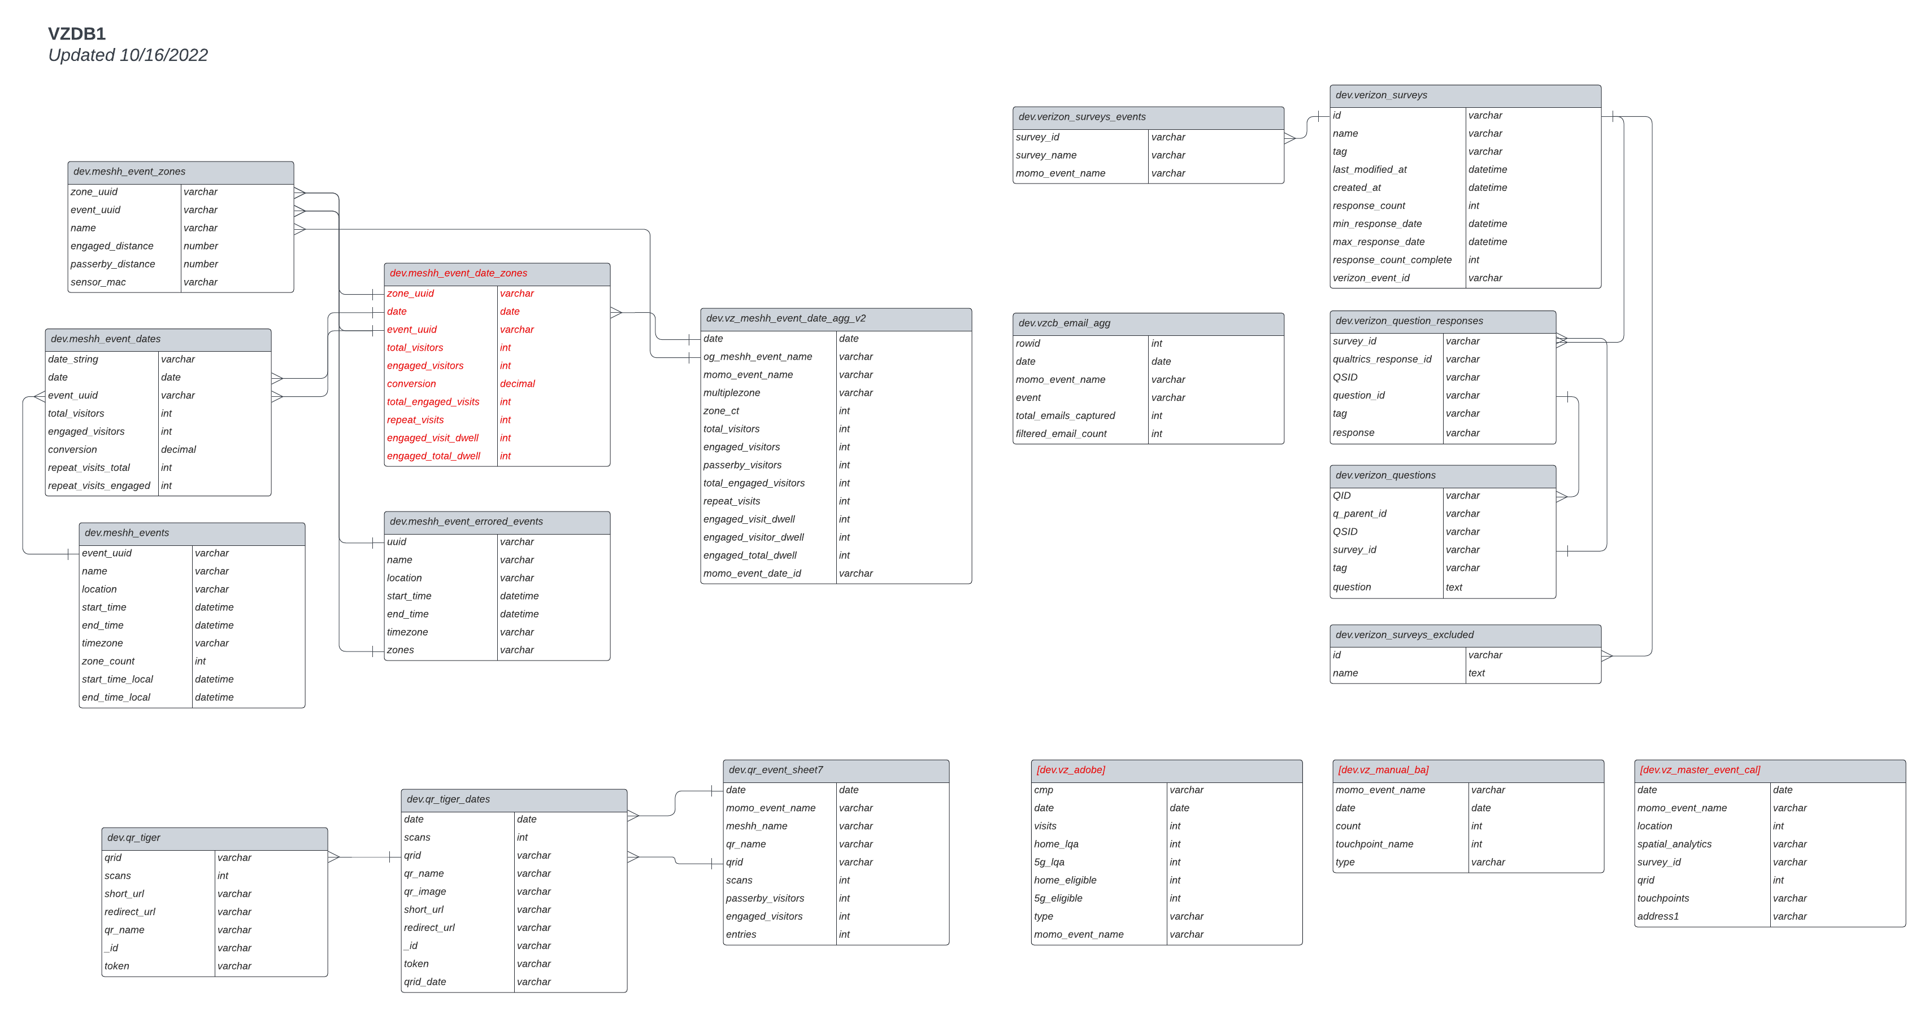
NEXT STEPS
Agree Technology – done
Document Business Process - done
Complete Framework UI, confirm core features
Prototype
QR Code Technology Review
Qualtrics API Current state documentation
Current Data Architecture To be updated
Create SQL /Dataverse Tables
Pressure Test Application
Plan Lunch
GOALS OF THIS DECK –BUSINESS PROBLEMS + HOW UXP SOLVES THEM
1. ACCOUNT INTERVIEWS: Pain Points + GOALS
2. PRODUCT FEATURES: V1, V2,
3,

Slide 2
UNIFIED EXPERIENCE PLATFORM
Notes:
Leadership Overview & Detailed Roadmap

Slide 3
TODAY
COCA COLA:
GOAL:
Centralized system for multi-location tour tracking.
Unified event ID assignment for better tracking and reporting.
Automated sample and engagement metric tracking.
AMEX:
GOAL:
Need historical data tracking for year-over-year insights.
More efficient brand ambassador staffing & scheduling.
Improve event engagement metric collection.
CONSTELLATION
GOAL:
Centralized system for multi-location tour tracking.
Unified event ID assignment for better tracking and reporting.
Automated sample and engagement metric tracking.
AMEX
Need historical data tracking for year-over-year insights.
More efficient brand ambassador staffing & scheduling.
Improve event engagement metric collection.
Coca-Cola
Centralized system for multi-location tour tracking.
Unified event ID assignment for better tracking and reporting.
Automated sample and engagement metric tracking.
Constellation Brands
Real-time data visibility for field teams.
Improved staffing workflows for brand ambassadors.
More structured client interaction & tracking.
Verizon
Visual tour logistics tool to optimize event routing.
Automated QR code & lead capture integration.
Intake form for streamlined out-of-scope event approvals.
WGS (William Grant & Sons)
Automated data consolidation from multiple sources.
Integrated calendar & reporting for all brands.
Improved team availability and workload tracking.

Slide 4
DATA SOURCES - TODAY
Currently, teams across different accounts report spending 10-15 hours per week manually inputting data, tracking events across multiple platforms, and consolidating reports.
AMEX | COKE | VERIZON | WGS
The BL team manually collects data from LETT and Google Docs, then inputs them into reports | Uses Google Sheets for touring events, requiring multiple manual updates per location | Event tracking in Smartsheet is manually copied into Google Sheets for client reporting | Relies on multiple entry points (SharePoint, PowerPoint, and emails) to compile post-event data
Google Docs/Sheets: Widely used for planning, scheduling, and initial data tracking.
Smartsheet: Utilized by Verizon and WGS for compiling event details and reporting.
Brandscopic: Used by Verizon for field data collection.
Proprietary Tools (LETT): Specific to AMEX for collecting and tracking event metrics.
PowerPoint/PDF: Used by Coke and WGS for client reporting.
QR Codes: Implemented by Verizon, WGS, and Constellation for real-time data capture.

Slide 5
TODAY PAIN POINTS
Pain Point | Problem | Solution
Data Fragmentation | Events tracked in multiple tools (Smartsheet, Google Docs, PPT). | Unified event management system with integrations.
Manual Event Recap | Teams manually input post-event data via email & PPT. | Automated data capture via QR, surveys, and system forms.
Inefficient Scheduling | No clear visibility of tour logistics & staffing gaps. | Interactive scheduling tool with calendar & "air traffic control" view.
Limited Real-Time Insights | Delayed reporting due to manual processing. | Live dashboard with real-time event performance metrics.
Complex Approval Process | Out-of-scope requests require multiple emails & manual estimates. | Automated intake form with cost estimation.
Inventory Blind Spots | No real-time tracking of event swag & samples. | Inventory module that deducts based on event usage.

Slide 6
PRODUCT
V1: MVP AIR TABLE (?)
Event Scheduling
Calendar Management
Automated Data Collection (QR Codes, Surveys, Check-ins, Qualtrics)
Real-Time Dashboard for Event Insights
Standardized Reporting Format (Automated Report Generation)
Staffing & Resource Assignment
Customizable Permissions & User Roles
Multi-Client Data Integration (e.g., Smartsheet, Google Docs, CRM tools)
V2: Future Enhancements (Post-MVP)
??Predictive Insights
??Client-Facing Dashboard for KPI Tracking
??API Integrations with External Tools (Eventbrite, Splash)
??? Intake Form for Out-of-Scope Requests
Basic Tour Routing & Logistics Tracking
Notes:
----
Changed project management to staff planning in 2nd bullet
Rationale: Want to ensure the focus is on scoping and estimation development / management vs detailed timeline mgmt / task tracking / deliverable routing (imagine the EXCO will think the latter when they see Project Management).
Another option is “project delivery”

Slide 7
PRODUCT
Core Functions
Event Scheduling & Calendar Management
  Centralized event calendar with filters by client, region, and team.
Real-Time Event Data Collection
  Automated collection from QR codes, lead forms, and surveys.
Tour & Logistics Planning
  Views to manage event routing.
Cross-Team Collaboration & Integration
  One system for business leadership, field teams, and event planners.

Slide 8
 | Amex | Verizon | Coke | Constellation | WGS
Client Request + Approval | Annual events are predicted and dates set in advance. For B2B and Theatre, short notice events are also managed. Teams receive briefs from AMEX with event details and objectives. | Client Request and Approval: Use Brandscopic for data collection and recapping. Implement an intake form for out-of-scope events. Approved events are documented in Google Sheets and Smartsheet. | Use Google Docs for scheduling and logistics coordination. Track events using a Google Doc project tracker and calendar. | Plan and manage events for multiple brands (Corona, Modelo, Pacifico). Use Google Docs for collaborative planning and real-time updates. | Use Smartsheets for calendar and scheduling. Collect event details from clients using Google Sheets and Microsoft Excel.
Planning | Use LETT (Live Event Tracking Tool) for data collection and metrics. Plan dates, venues, budget, and staffing with XP partners. | Create estimates and rate cards automatically using the intake form. Visualize event routing and logistics. | Different types of events (Touring, One-off, 2/3 Day Events) are planned using Google Docs. | Detailed planning for events like Modelo Custom Shop. Manage logistics, staffing, and creative content with specialized teams. | Create and manage event plans with input from brand teams and local clients. Use ROI forms and intake forms for event requests.
Execution | Execute events, collect metrics using LETT, clickers, surveys, and inventory counts. Brand Ambassadors (BAs) and other staff are managed by event staffing agencies. | Execute events with support from field managers and BAs. Collect data using QR codes and digital tools. | Execute events, use staffing agencies for BAs. Collect data on engagement, samples, and interactions. | Execute events with BAs recruited through staffing agencies. Manual data entry into Main Event or Google Sheets. | Execute events with local staffing and BAs. Data collected by event producers and input into decks (PPT) for clients.
Reporting | Metrics are entered into a Google Doc and passed to Wasserman for main reporting. Metrics include card member engagement, prospect information, transactions, charge volume. | Compile data in Smartsheet for weekly analytics reports. Metrics include scans, leads, engagements, and sales | Data tracked in Google Docs and shared through PowerPoint or PDF presentations. Metrics include participant engagement, digital interactions, and ROI. | Compile internal and client reports using Google Slides. Metrics include engagement metrics, attendance, and feedback. | Compile data in PowerPoint decks and email reports. Metrics include attendance, samples, sales, and cost per consumer.
Tools | LETT for data collection. Google Docs for tracking and reporting. Wasserman for comprehensive reporting. | Brandscopic for data collection. Google Sheets and Smartsheet for scheduling and reporting. QR codes for data capture. | Google Docs for scheduling and tracking. PowerPoint/PDF for client reports. Staffing agencies for event personnel. | Google Docs for planning and collaboration. Main Event and Google Sheets for data entry. Google Slides for creating reports. | Smartsheets for scheduling. Google Sheets and Microsoft Excel for status tracking. PowerPoint for client recaps and reporting.

Slide 9
ARCHIVE

Slide 10
FUTURE
Increased Efficiency: Eliminates redundant data entry and integrates scheduling and reporting into a single system.
Real-Time Insights: Provides instant access to event performance, logistics, and resource allocation.
Cost Savings: Reduces manual work hours spent on data entry, approvals, and reporting.
Scalability & Flexibility: Supports multiple event types, brands, and client needs while allowing customization.
Improved Decision-Making: Centralized data enables more informed strategic planning and resource allocation.
Enhanced Collaboration: Provides a single source of truth for event planners, business leaders, and field teams.

Slide 11
DIAGRAMS

Slide 12





UXP COMPONENTS AND FLOW
USER INTERFACE
DATA
CAMPAIGN
New entry
DATABASE
EVENT
EVENT
Update data
Other system data
Other system data
Log data
EVENT
EVENT
CAMPAIGN ID
EVENT ID
EVENT ID
Other system data
Other system data
Display data
CAMPAIGN DATA
EVENT DATA
EVENT DATA
SYS DATA
Some apps will have a connection to Create entries
And send data back
Update data
OTHER SYSTEMS
ENRICHMENT & COLLECTION
AUTOMATION
Interrogate data
SURVEYS
QR CODES
SCHEDULE
FIELD MANAGEMENT
LOCATION
Receive information
OTHER
OTHER

Slide 13


UXP COMPONENTS AND FLOW
USER INTERFACE
DATA
AI & INSIGHT
CAMPAIGN
DATABASE
EVENT
EVENT
Other system data
Other system data
EVENT
EVENT
CAMPAIGN ID
EVENT ID
EVENT ID
Other system data
Other system data
CAMPAIGN DATA
EVENT DATA
EVENT DATA
SYS DATA
OTHER SYSTEMS
ENRICHMENT & COLLECTION
AUTOMATION
SURVEYS
QR CODES
SCHEDULE
FIELD MANAGEMENT
LOCATION
OTHER
OTHER

Slide 14
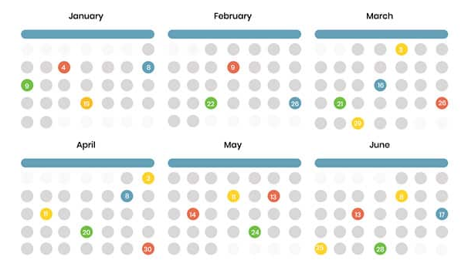












UNIFIED EXPERIENCE DATA ECOSYSTEM
Unified data aggregates data from disparate sources into a single view providing complete and accurate answers to critical questions.
Activation Schedule
Business Leadership
Unified Experience Data
Unified Experience Tracker (UET)
Data Driven Insights
Activation Insights
Event Hub
Inc. Cross Client Benchmarking
Field Team
Conversational Insights
Training & Media
Staffing Agency Integration
Wrap Data
Data Driven Insights
Field Management
Other location & event intelligence
Cognitive Services

Slide 15
UNIFIED EXPERIENCE DATA ECOSYSTEM
Unified data aggregates data from disparate sources into a single view providing complete and accurate answers to critical questions.
Activation Schedule
Unified Experience Tracker (UET) and Input Procedure
A front-end Input application and organization-wide process/system for collecting Activation Details and information: Activation Name, Activation Date, Activation Client, and Activation Location.
Unified Experience Data
Activation Insights
Field Management
Portfolio-wide standardized system for managing event details, assets, and on-site wrap information. It includes a cloud/web-based tool accessible from anywhere for real-time updates and version control, eliminating the need for multiple spreadsheets.
Conversational Insights
Cognitive Services

Slide 16
UNIFIED EXPERINCE BENEFITS
FEATURE | BENEFIT | PAIN SOLVED
Unified Experience Tracker (UET) | Centralized management of activation data | Scattered and disorganized data across multiple systems
Master campaign Identifier & event date Identifier | Unique identifiers for each campaign and each day of the event | Enabling the data team the ability to start work with greater agility
Unified Database | Consolidated data storage | Redundancy and inconsistency in data storage
Activation Calendar | Easy visualization of scheduled events | Inefficient event planning and tracking
Client Power BI Dashboards | Customizable data visualization for clients | Limited client access to data and insights
Field System | Single system for all field related data to live. Who worked the events, what materials do they need for training, and what happened during activations. | Inconsistent and disorganized data being recorded per event from field teams.
API Integration | Seamless communication with field management systems Real-time data updates across UET and field management systems | Manual data transfer and synchronization Inconsistent data between systems

Slide 17
KEY DELIVERABLES
Unified Experience Tracker (UET) and Input Procedure
A front-end Input application and organization-wide process/system for collecting Activation Details and information: Activation Name, Activation Date, Activation Client, and Activation Location.
Unified Experience Datawarehouse & APIs
One location for all IDs and data generated from UET.
Data models and processes (ETL) to manage changes/updates within UET
Centralized data infrastructure that can be enriched with additional IDs and data from other 3rd party systems.
Bidirectional APIs to communicate with 3rd party services to send and receive data.
Organization-wide BI/Analytics Dashboard (Experiential Intelligence Dashboard)
An accessible and interactive web-hosted dashboard visualizing data from the data warehouse via KPIs and other metrics for Momentum and its clients.
Field Management System
A single solution for all field staff to access event information details, training materials and record event recaps.
Activation Calendar
Enable visibility into the Momentum activation calendar. Who, what, when and where.
Conversational Insights
Leveraging AI to provide conversational insights based on aggregated data. It would provide Momentum with a user-friendly interface to access data and gain valuable insights, though conversion.

Slide 18
PROOF OF CONCEPT

Slide 19
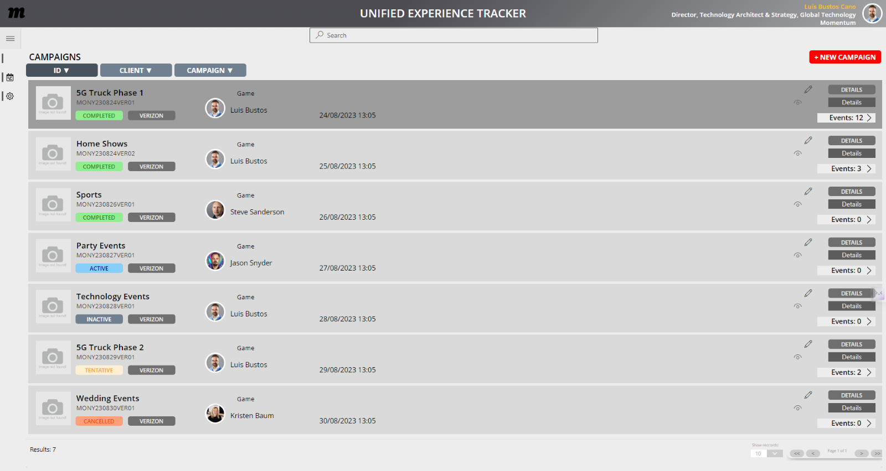
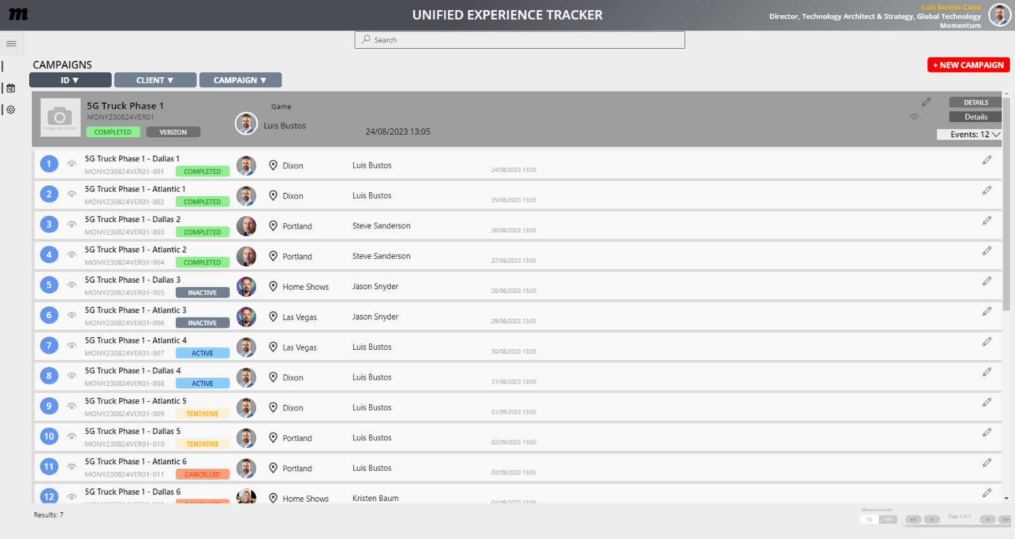
CAMPAIGNS & EVENTS
Create, edit, delete Events
Display Event data
Create an intelligible campaign ID
Sorting search returns based on criteria:
ID, Name, Status, etc
Pagination
Retrieve AD data for event originator/assignee
Display map data and standardized address

Slide 20
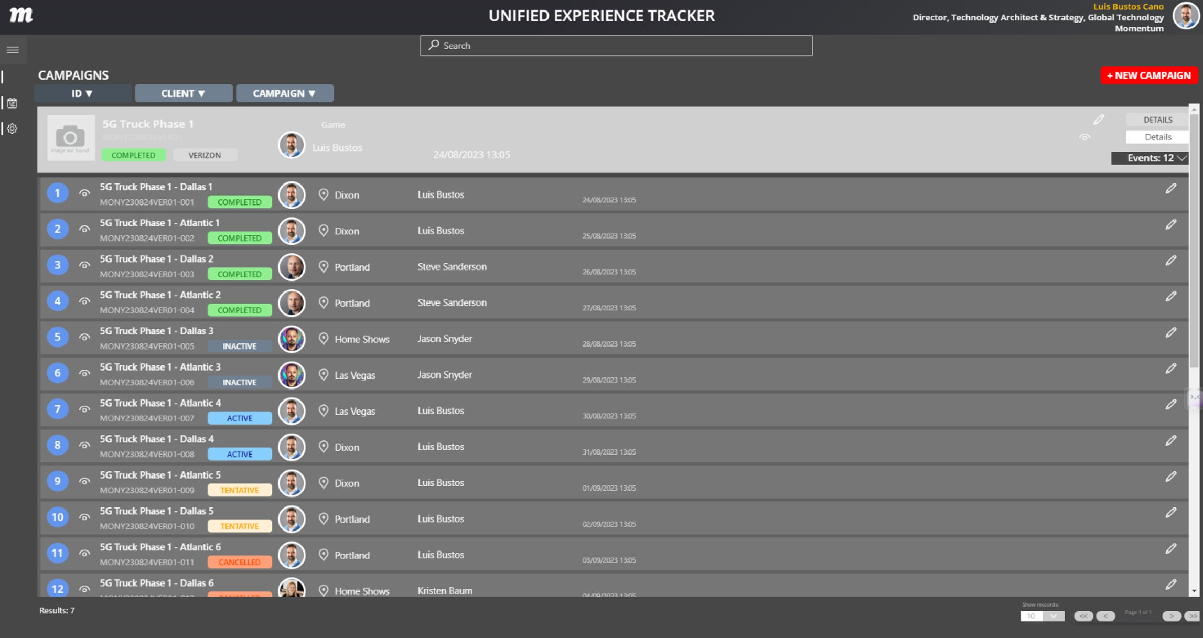
CAMPAIGNS & EVENTS
TURES
Theme variations stored at user-level permissions
This can include read/write permissions or view only permissions
Configurable by:
Client
User
Team

Slide 21
NEXT STEPS

Slide 22
Immediate Priorities
Define MVP Scope – Confirm the core feature set for launch.
System Architecture – Identify integrations with existing tools (Smartsheet, Google Docs, QR, CRM).
User Interface Design – Develop a dashboard that consolidates scheduling, logistics, and reporting.
Mid-Term Priorities
Prototype Development – Create a working prototype for early testing.
User Testing & Feedback – Conduct testing with account teams to refine features.
Refine Reporting & Analytics – Improve real-time reporting dashboards.
Long-Term Priorities
Automation & AI Implementation – Develop advanced forecasting & scheduling optimization.
Scalability & Customization – Expand for future needs, including international event tracking.
Client-Facing Reporting Tool – Create interactive reports for external stakeholders.

